Slide 1
Project a – designing dmz, vlan & wan network.
TAMUK QuickStart – cybersecurity bootcamp
Prof. drew gansmiller
Elisha Ngwana

Slide 2
Project task
Project tasks are:
1. Install VirtualBox and extensions.
2. Using the supplied VMs, install the Router-FW, DNS Server, Webserver, and CEO PC, ensuring they are connected to the correct network segment.
3. Install a Kali Linux computer in each of the 3 network segments.
4. Using the CEO PC, open www.seclab.net with Firefox. Troubleshoot and resolve any issues discovered.
5. Use FTP to download Social-Media-Security-Policy to the CEO PC.
6. Document the OS version and IP configuration of the CEO PC.
7. Create a new user account on the web server.
8. Document the OS versions and IP configurations of the web and DNS servers.
9. Use nmap on Kali Linux to perform port scans on the DNS and Web servers. Document the open ports on each server.
10. Verify through that the trusted network is protected from the untrusted network.

Slide 3

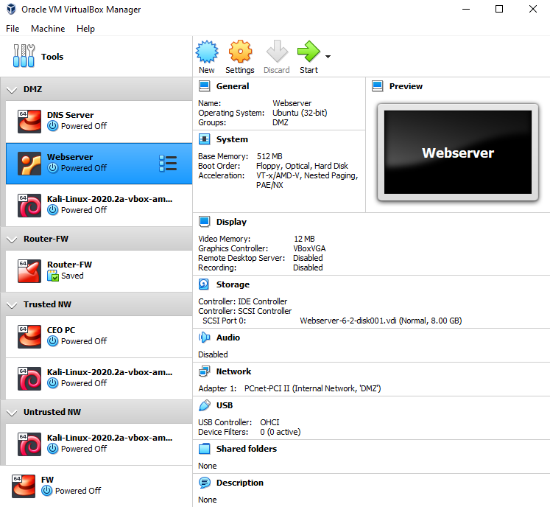
Virtual box zones
Demilitarized Zone (DMZ)
Router- FW
Trusted Network
Untrusted Network

Slide 4
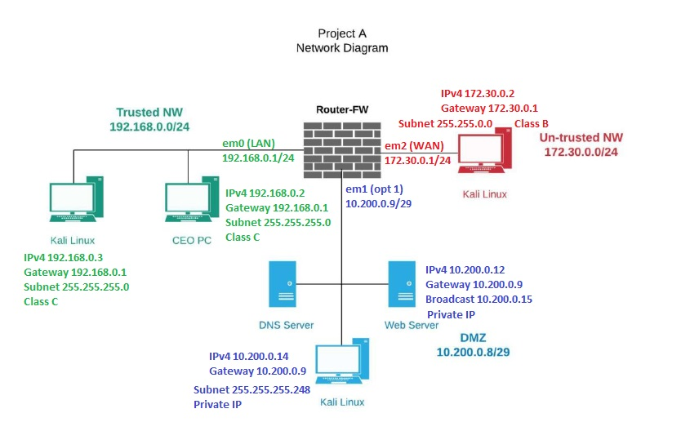
Network topology
Trusted NW – Class C Gateway em0 192.168.0.1/24 | Subnet 255.255.255.0
DMZ – Private IP Gateway opt1 10.200.0.9/29 | Subnet 255.255.255.248
Untrusted NW – Class B Gateway em2 172.30.0.1/24 | Subnet 255.255.0.0

Slide 5
Software versions on vm images
VM Image | Zone | IP Address | Default Gateway | OS Version
CEO PC | Trusted NW | 192.168.0.2 | 192.168.0.1/24 | Red Hat 64-bit CentOS 6.4
Kali Linux 1 | Trusted NW | 192.168.0.3 | 192.168.0.1/24 | Debian 64-bit
Webserver | DMZ | 10.200.0.12 | 10.200.0.9/29 | Ubuntu 32-bit
DNS Server | DMZ | 10.200.0.11 | 10.200.0.9/29 | Red Hat 64-bit
Kali Linux | DMZ | 10.200.0.14 | 10.200.0.9/29 | Debian 64-bit
Router-FW | Router |  |  | FreeBSD 64-bit
Kali Linux 2 | Untrusted NW | 172.30.0.2 | 172.30.0.1/24 | Debian 64-bit

Slide 6
Network observations
Trusted nW - LAN
Dmz – opt 1
Untrusted nw - wan
CEO PC 192.168.02 can ping all computers in the Network (DMZ, WAN & LAN) via Firewall config. But cannot be pinged by the Untrusted WAN Kali Linux. Hierarchical stateful concept. Also connects to Web Server FTP.
Kali Linux 1 192.168.0.3 shares the same gateways as CEO PC, thus can monitor traffic via the Gateway 192.168.0.1. Has same subnet as CEO PC.
Web Sever 10.200.0.12 has preconfigured IPv4 address, pings all hosts in the DMZ, Trusted and Untrusted networks. Can be pinged by all host too even the Untrusted.
Kali Linux 10.200.0.14 shares the same Gateway 10.200.0.9 as Web Server and monitors incoming & outgoing traffic in the DMZ. Can be pinged by all hosts too which a subnet of 255.255.255.248.
DNS Server – 10.200.0.11
1. Kali Linux 3 172.30.0.2 operates in the WAN region connected to the open web but before the Firewall. It is the exposed part of the network; thus the Firewall prevents the flow of traffic from here to the trusted LAN which hosts the CEO PC. It is at the lowest level of the network chain.

Slide 7
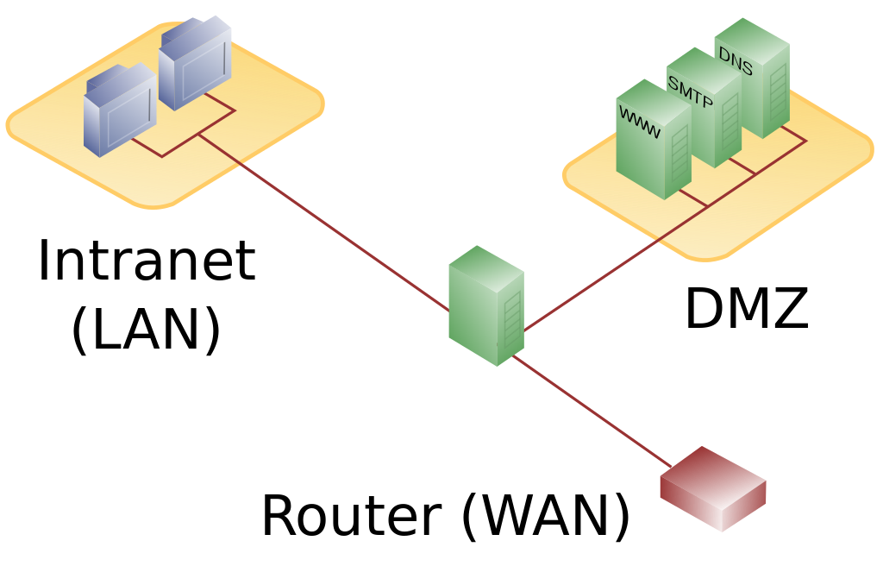
Three-legged or single firewall dmz
This configuration uses 1 Firewall to establish a DMZ and a secure internal LAN from the WAN provided by the ISP (external).
The Firewall becomes the single point of failure as it handles all traffic to/from the internal network and DMZ.
The Firewall rules allow defined traffic via open ports to the DMZ. Closed ports cannot transmit data to the DMZ from the WAN.

Slide 8
Stateful FIREWALL
The firewall blocks traffic from Untrusted NW to Trusted NW replying any such pings as “network unreachable”
It protects the DMZ from unwanted traffic by limiting the number of open ports, thereby limiting the attack surface. (Open Port images - next slide)
During TCP, the Firewall required a fully established three-way handshake of SYN ➔ SYN/ACK ➔ ACK to establish a connection.
During FTP file transfer, the CEO PC send SYN request, the Web Server ACK the availability & requests Login. The CEO PC logs-in SYN/ACK, Webserver confirmed the credentials via Firewall rules and opens FTP = ACK complete.

Slide 9
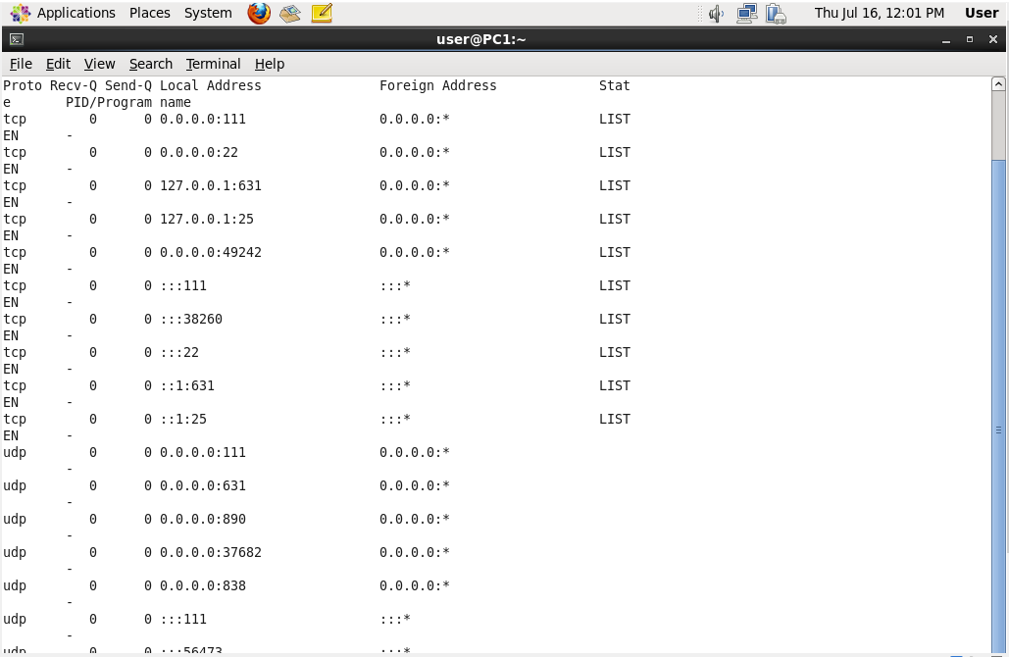
OPEN PORTS on CEO PC
Port 111 TCP / UDP
Port 22 TCP
Port 631 TCP / UDP
Port 25 TCP
Port 49242
Port 890 UDP
Port 37682 UDP
Port 838 UDP

Slide 10
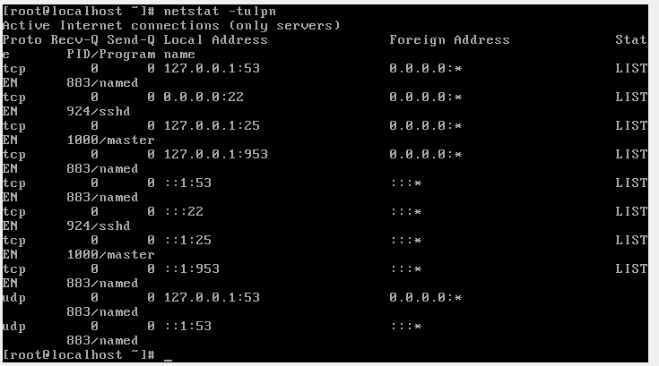
Open ports on web server
Port 993/53 TCP
Port 942/22 TCP
Port 1000/25 TCP
Port 883/958 TCP
Port 883/53 UDP
Port 924/25 TCP
Port 1000/953 TCP
Port 883/53 UDP

Slide 11
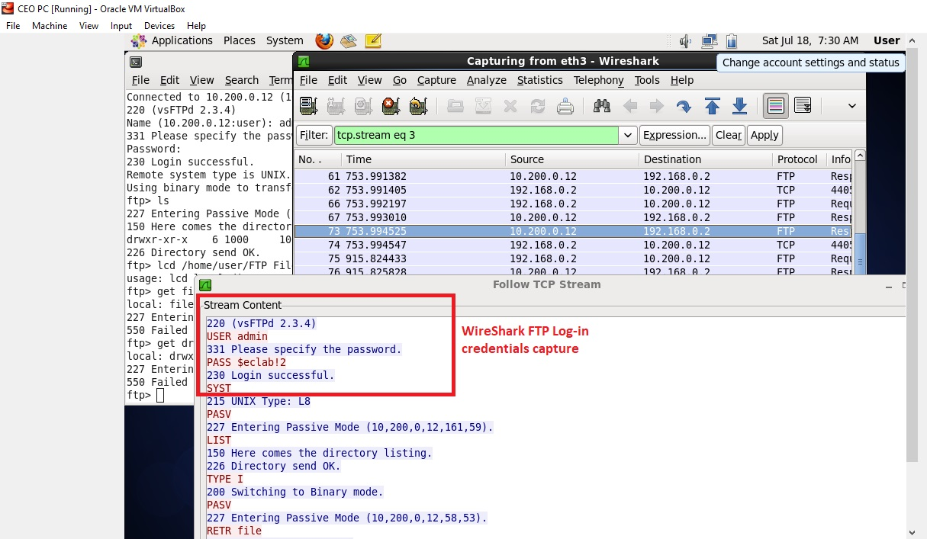
CEO PC FTP file transfer
Open Wireshark
Open Terminal
Gain Root Access
Establish FTP connection
List Files
Create Local storage
Transfer FTP file
Monitor Wireshark FTP traffic & open TCP frame content
Username & Password visible

Slide 12
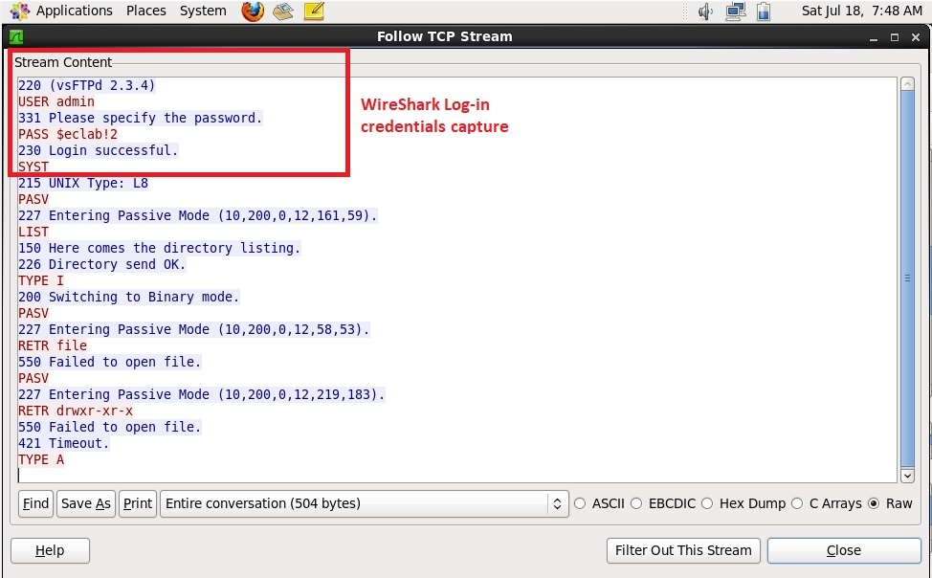
Wireshark - FTP TCP stream
The first 4 lines show the USER admin and PASS $eclab!2 captured by Wireshark.
Even goes further to highlight the various TCP requests transmitted between the CEO PC & Web Server.

Slide 13
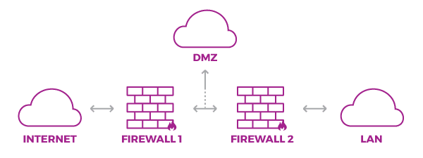
Thank you!

